Slide 1
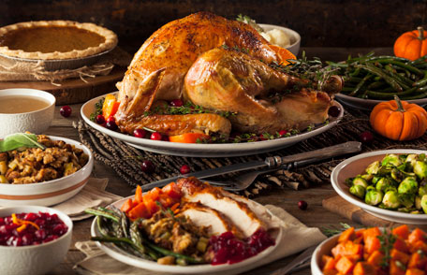

Thanking USDA for Thanksgiving Dinner
Rob Griesbach
Office of Technology Transfer

Slide 2
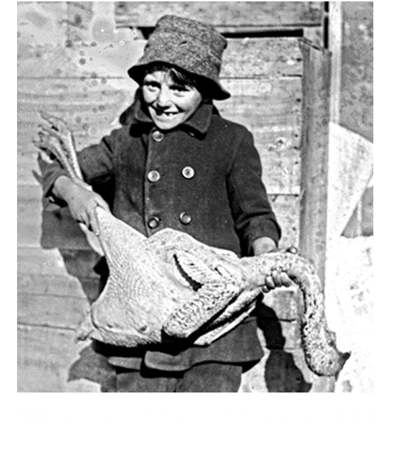
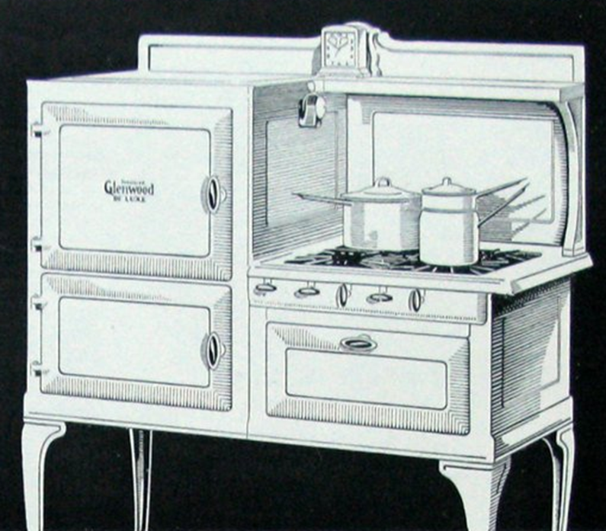

Slide 3
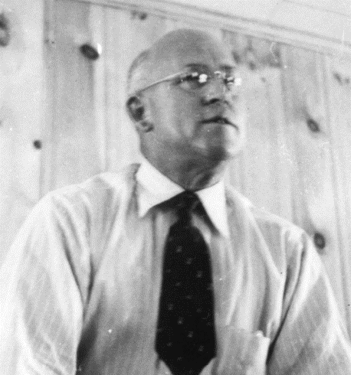
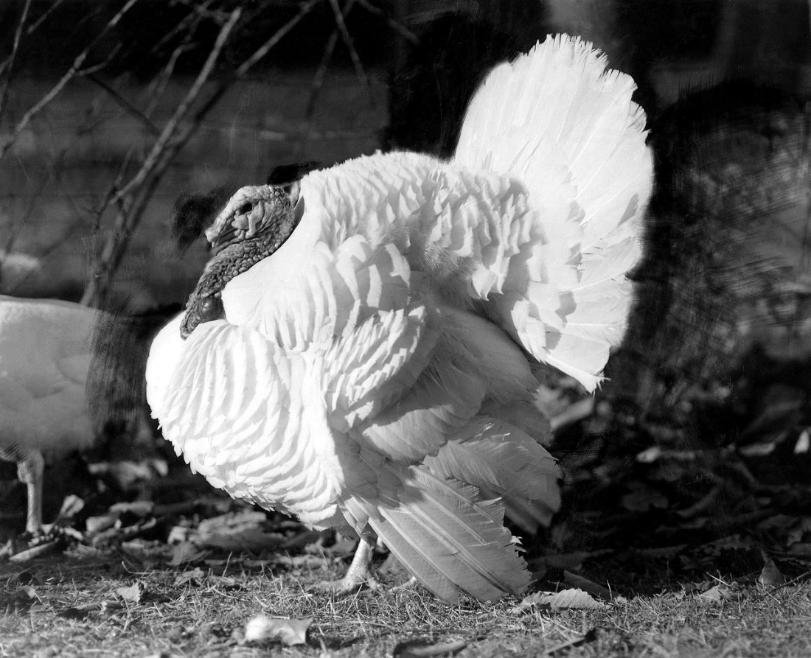
1947 Beltsville Small White
10-15 lbs.
More white meat
Fit home ovens
Stanley Marsden

Slide 4
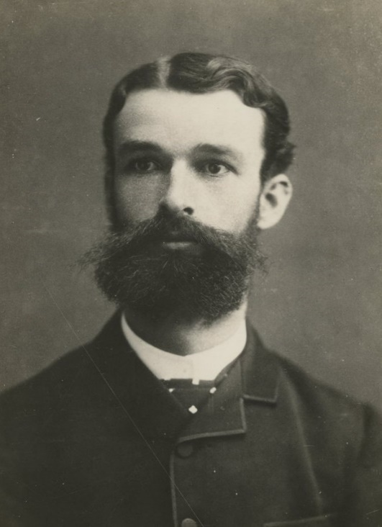
1900 Salmonella discovered
Theobald Smith
1906 Meat Inspection Act
1926 Poultry Inspection Service

Slide 5
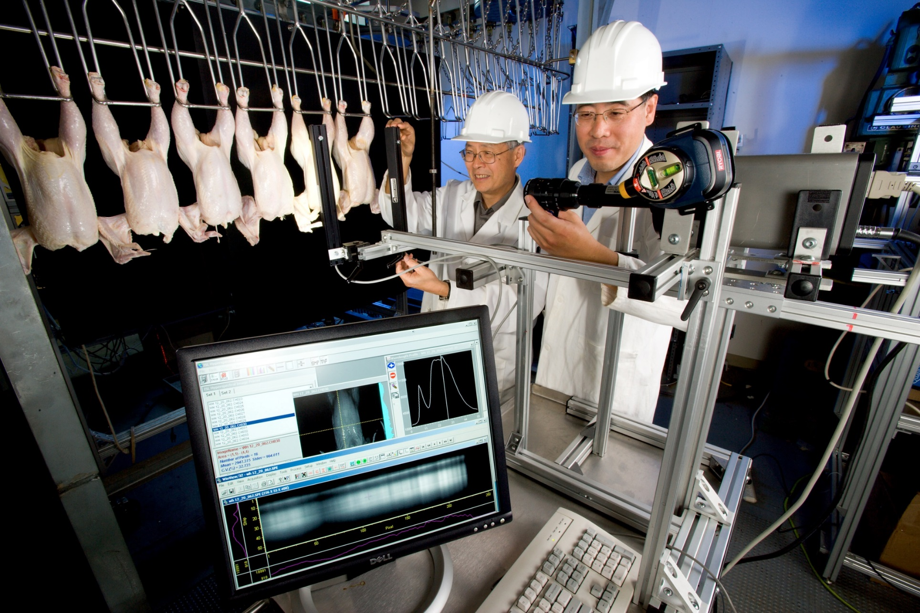
2008 Automated Online Inspection
Yud-Ren Chen, Moon Kim, Kuanglin Chao

Slide 6
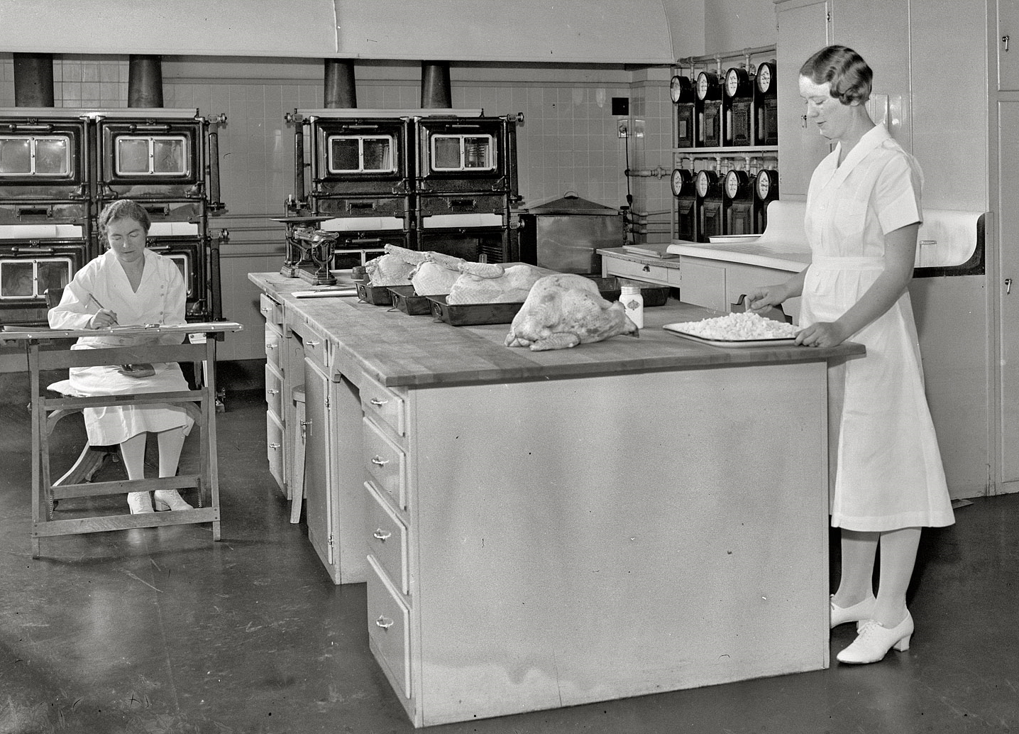
1937 Cooking recommendations
Lucy Alexander and Jessie Lamb

Slide 7
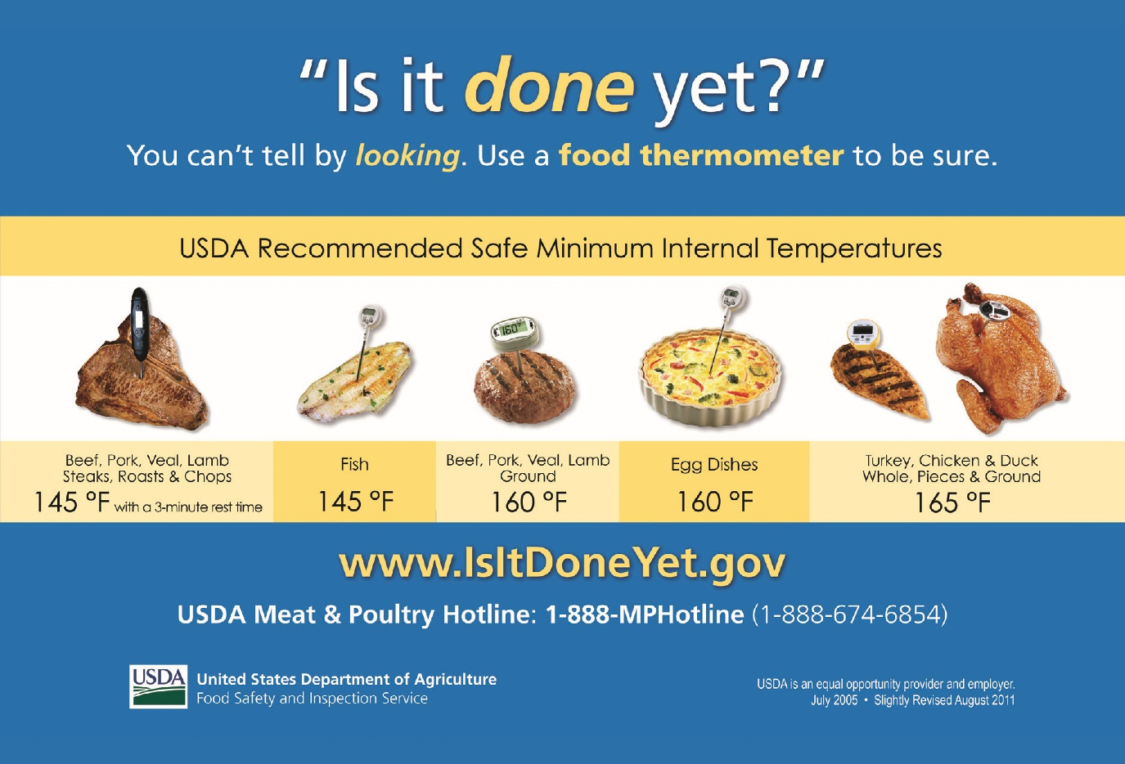

Slide 8
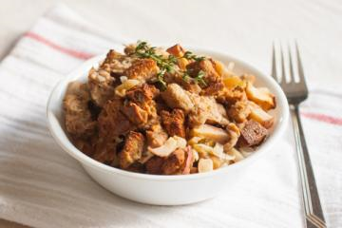

Slide 9
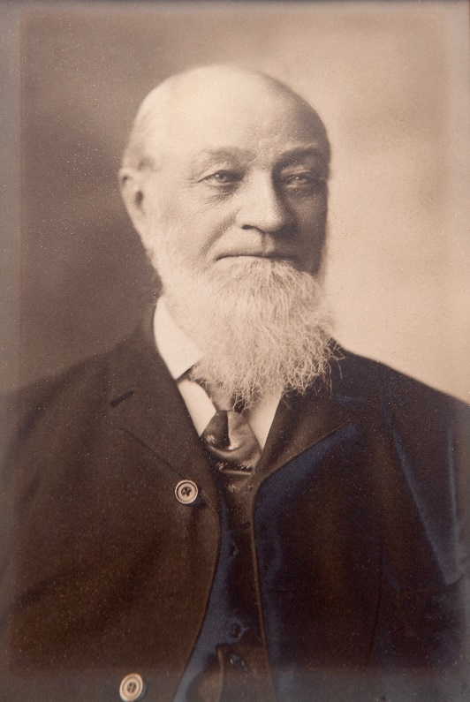
1868 ‘Tappahannock’
Spring wheat
High yield
Disease resistant
High flour quality
Wide adaptability
William
Saunders

Slide 10
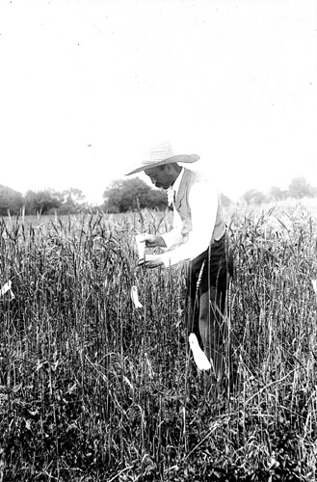
1898 Russia Wheat Collection Trip
1900 ‘Kharkov’
Winter wheat
Cold hardy
Expanded wheat production to the western US
Mark
Carleton

Slide 11
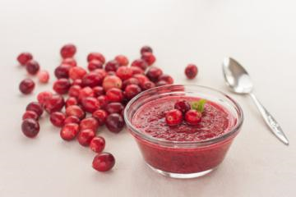

Slide 12
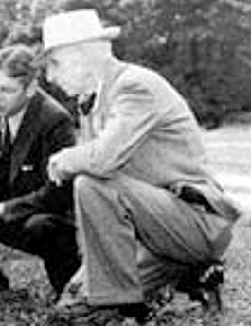
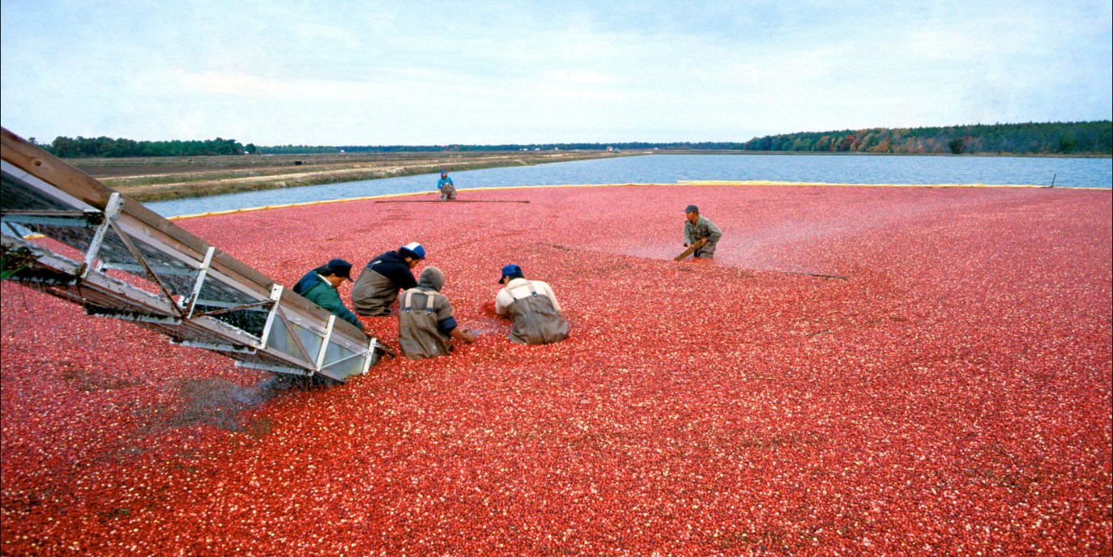
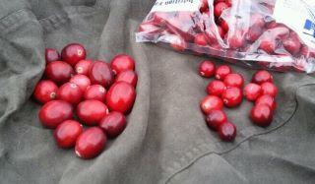
1950 ‘Stevens’
  1st man-made hybrid
  Increased yield
  Disease resistant
  51% current production
Herbert
Bergman

Slide 13
Cranberry Harvest
Barrels per Acre

Slide 14
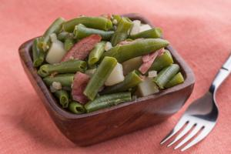

Slide 16
National Photo Company 1935

Slide 17
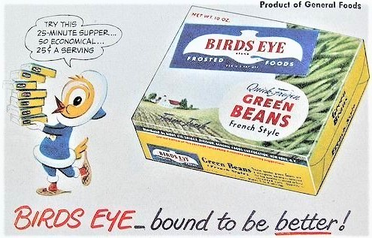

Slide 18
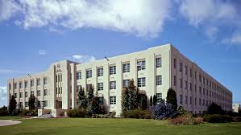

1948-1956 Time-Temperature Tolerance
Western Regional Research Center
Albany CA
Developed analytic methods for measuring food quality
Determined critical temperatures & procedures for creating & maintaining quality frozen food
2002

Slide 19
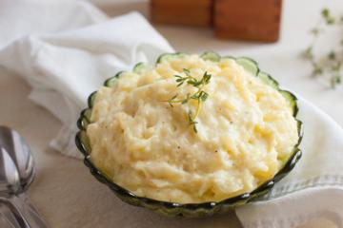

Slide 20
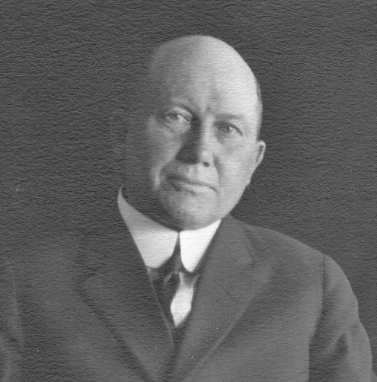
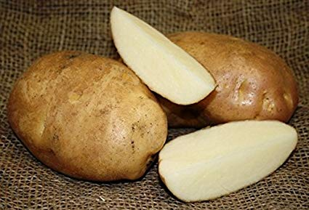
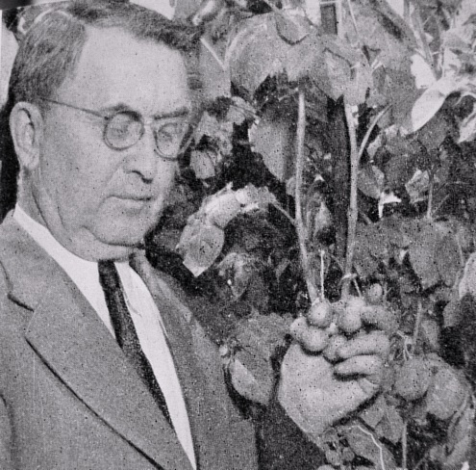
Charles Clark
1932 ‘Katahdin’
    Virus resistant
    Widely adapted
    Grown commercially into the 1970s
Frederick Stevenson

Slide 21
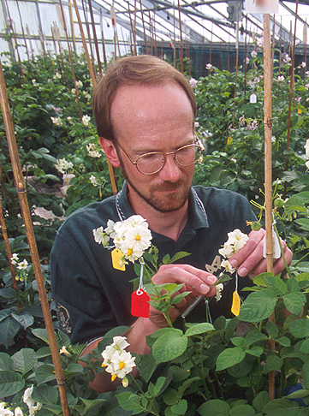
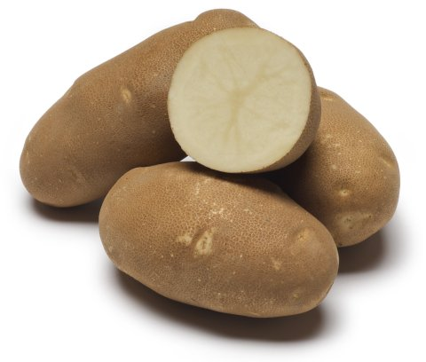
2010 ‘Clearwater Russet’
    38% greater protein
    Disease resistant
    Selected by McDonalds
Richard Novy
USDA-ARS
Richard Novy
Jonathan Whitworth
Dennis Corsini
Joe Pavek
Charles Brown
University of Idaho
Jeff Stark
Steve Love
Washington State University
N. R. Knowles
Mark Pavek
Oregon State University
M. I. Vales
Steve James
Dan Hane
Clint Shock
Brian Charlton
Tina Brandt
Sanjay Gupta
Nora Olsen

Slide 22
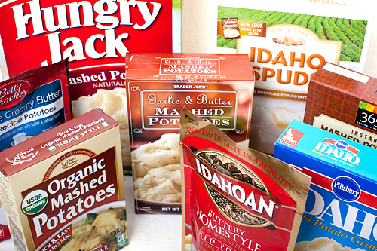

1956
Potato Flakes
Miles Willard
James Cording
John Sullivan
2007

Slide 23
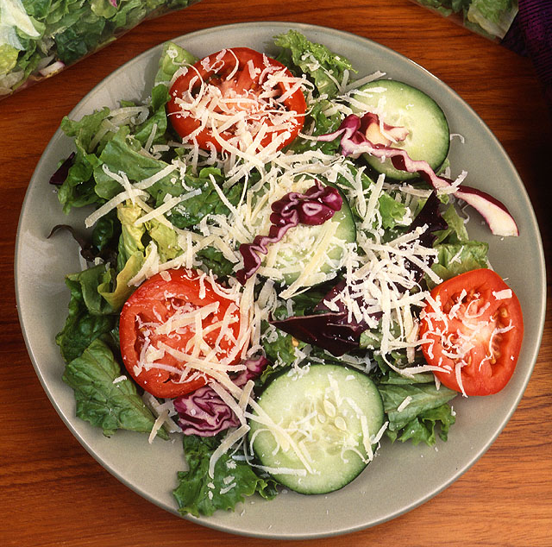

Slide 24
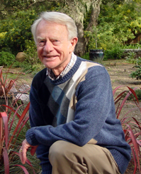
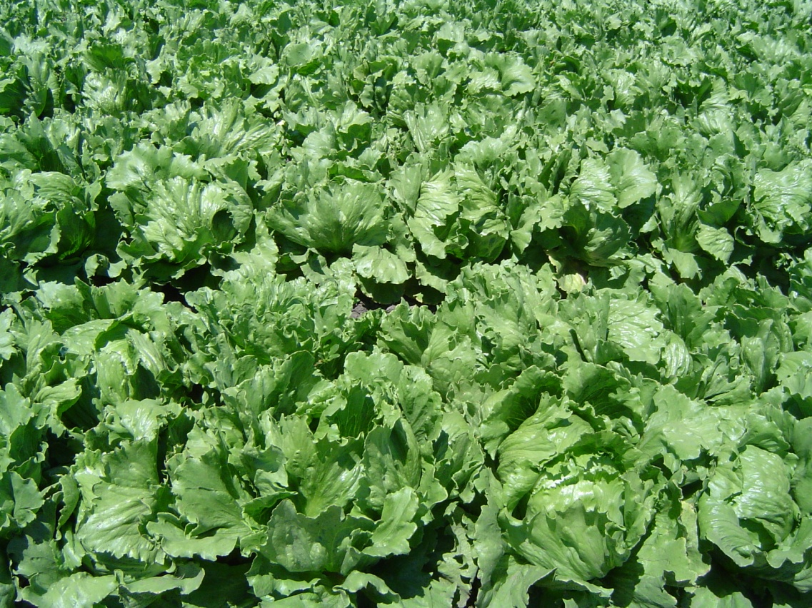
1975
‘Salinas’
Edward Ryder
world‘s most
widely planted
lettuce

Slide 25
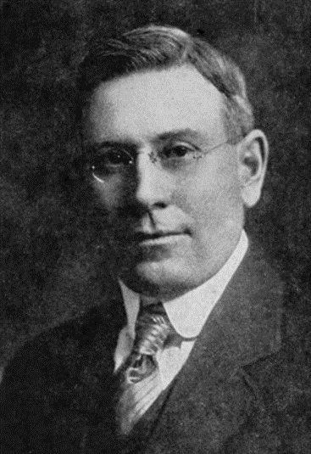
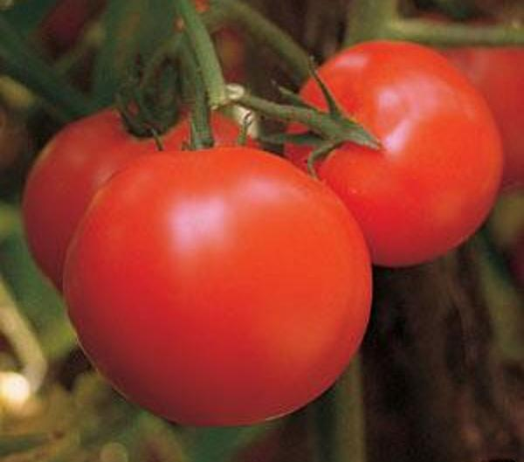
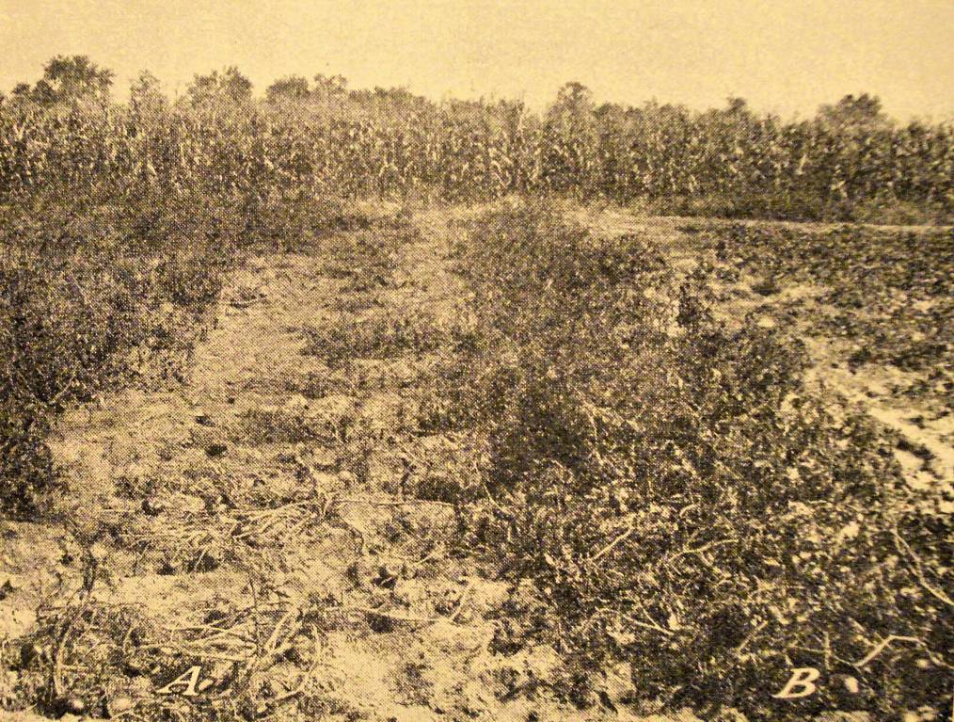
1917 ‘Marglobe’
Fungal disease resistance
In the background of almost all tomatoes
Frederick Pritchard

Slide 26
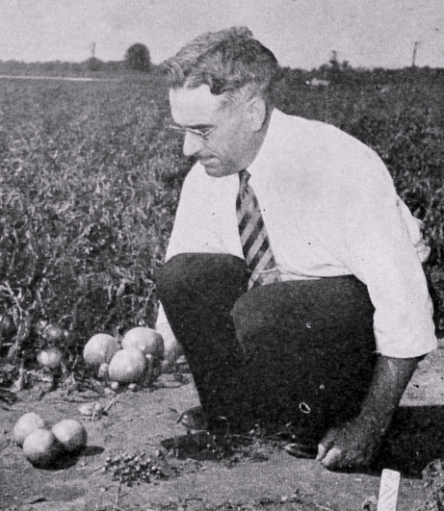
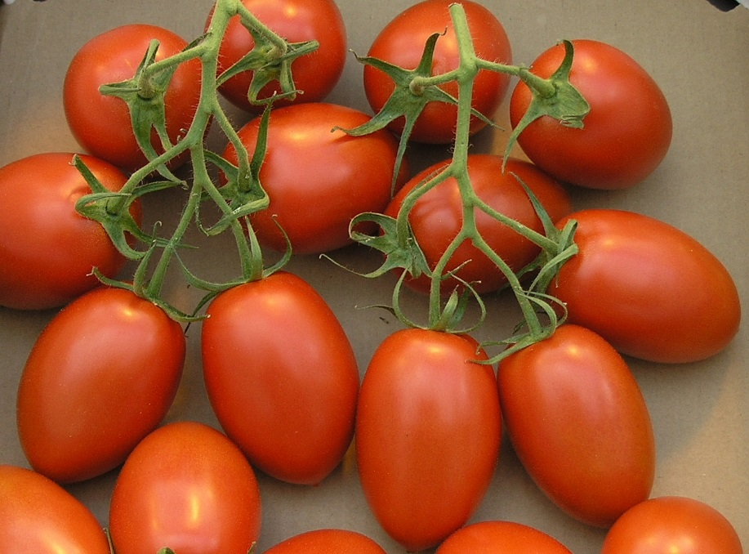
1955 ‘Roma’
William Porte
Now a generic name
pear-shaped tomato with thick walls
used in canning and making paste

Slide 27
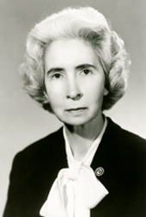
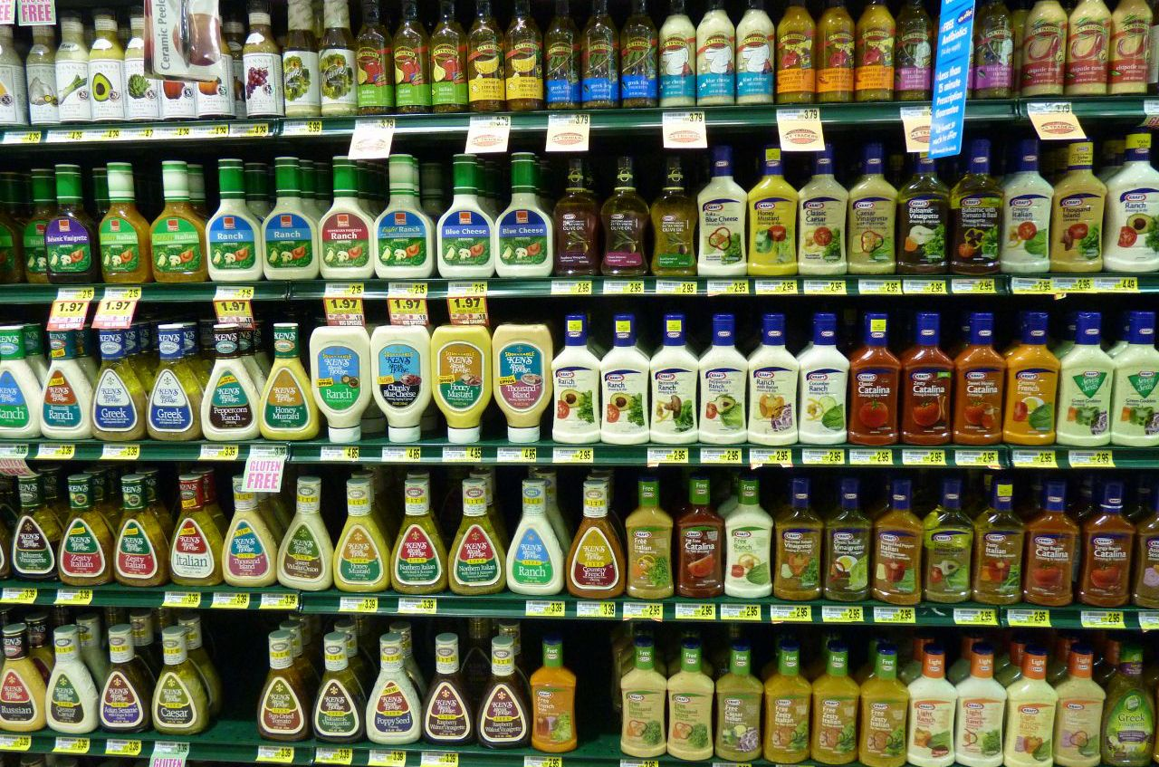

1950’s Xanthan Gum
Natural occurring polysaccharide
Thickening agent
Keeps oil and vinegar from separating
Used in nearly all salad dressings and ice cream
Allene
Jeanes
2017

Slide 28
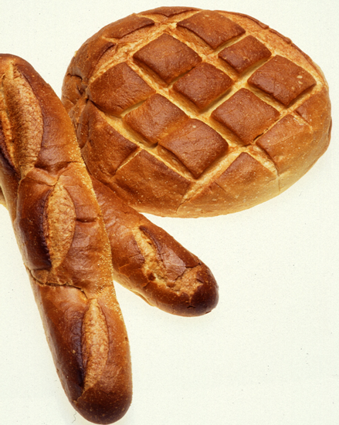
1971 Sourdough yeast discovered
Lactobacillus sanfranciscensis
Leo Kline and
Ted Sugihara

Slide 29
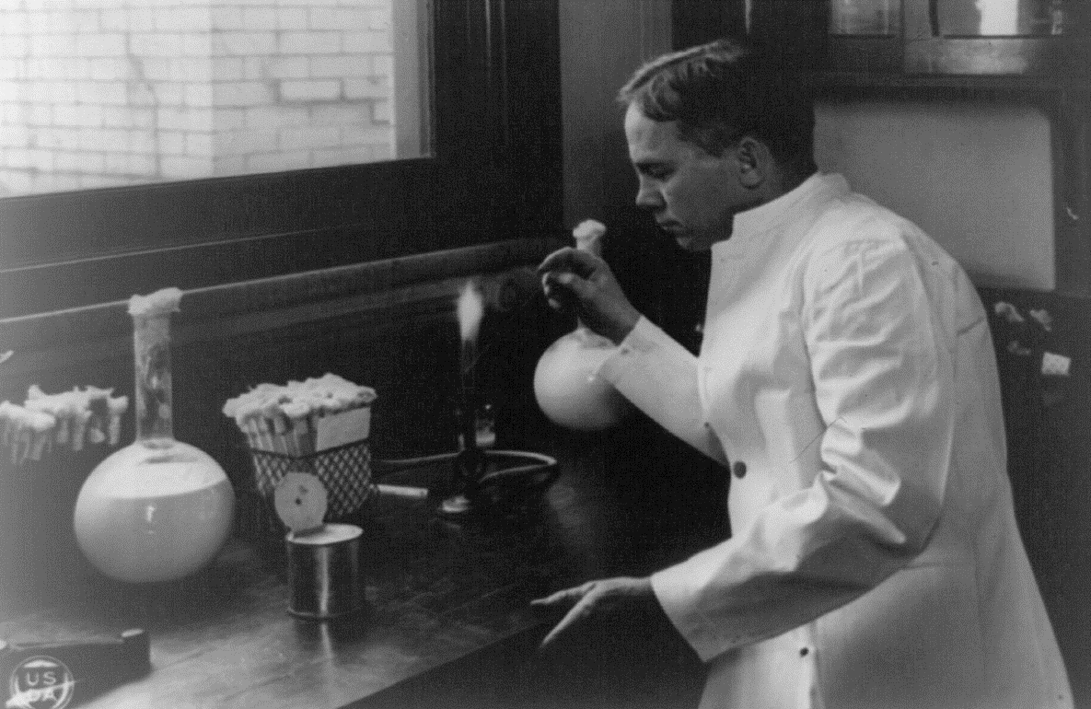
1904
Sweet Cream
Butter
Lore Rogers

Slide 30


Slide 31
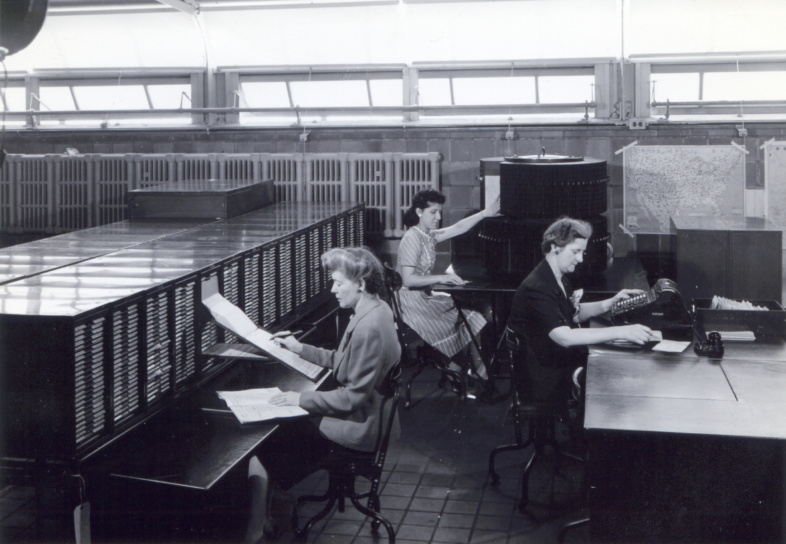
1908 National Cow-Testing

Slide 32
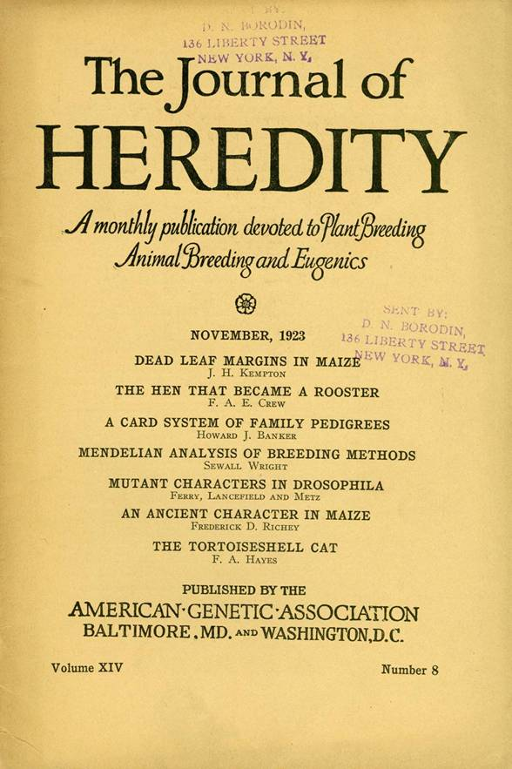
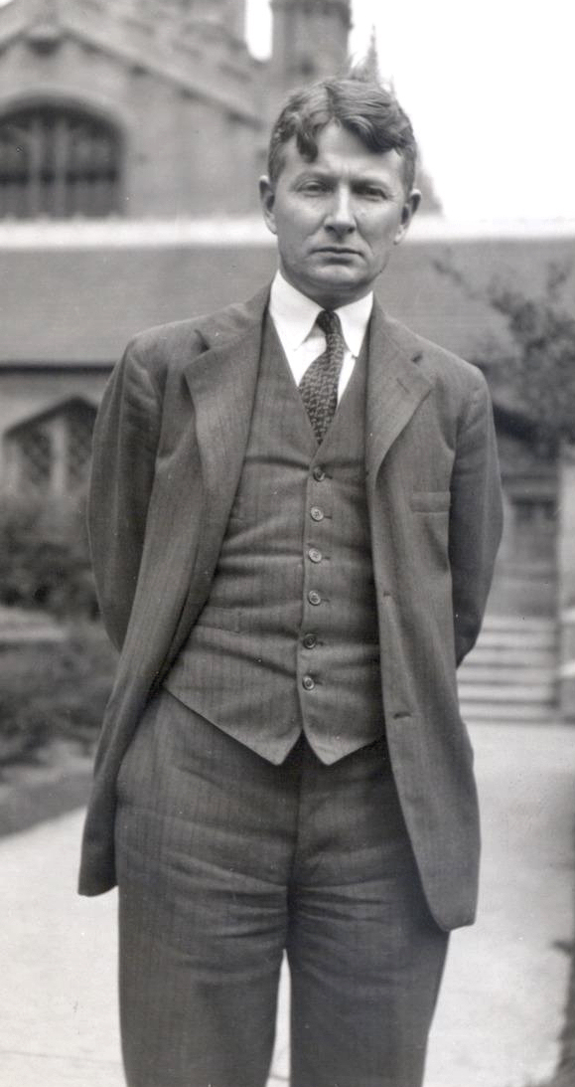
1925
Developed science of quantitative inheritance
Sewall Wright

Slide 34

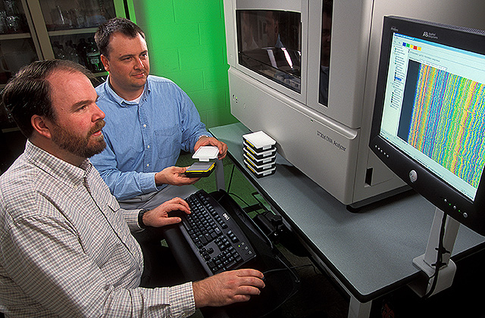
2008 Bovine SNP50 Chip
      54,000 markers
      At Birth vs. 3 years
      ~$150.00
Curt Van Tassell & Tad Sonstegard

Slide 35
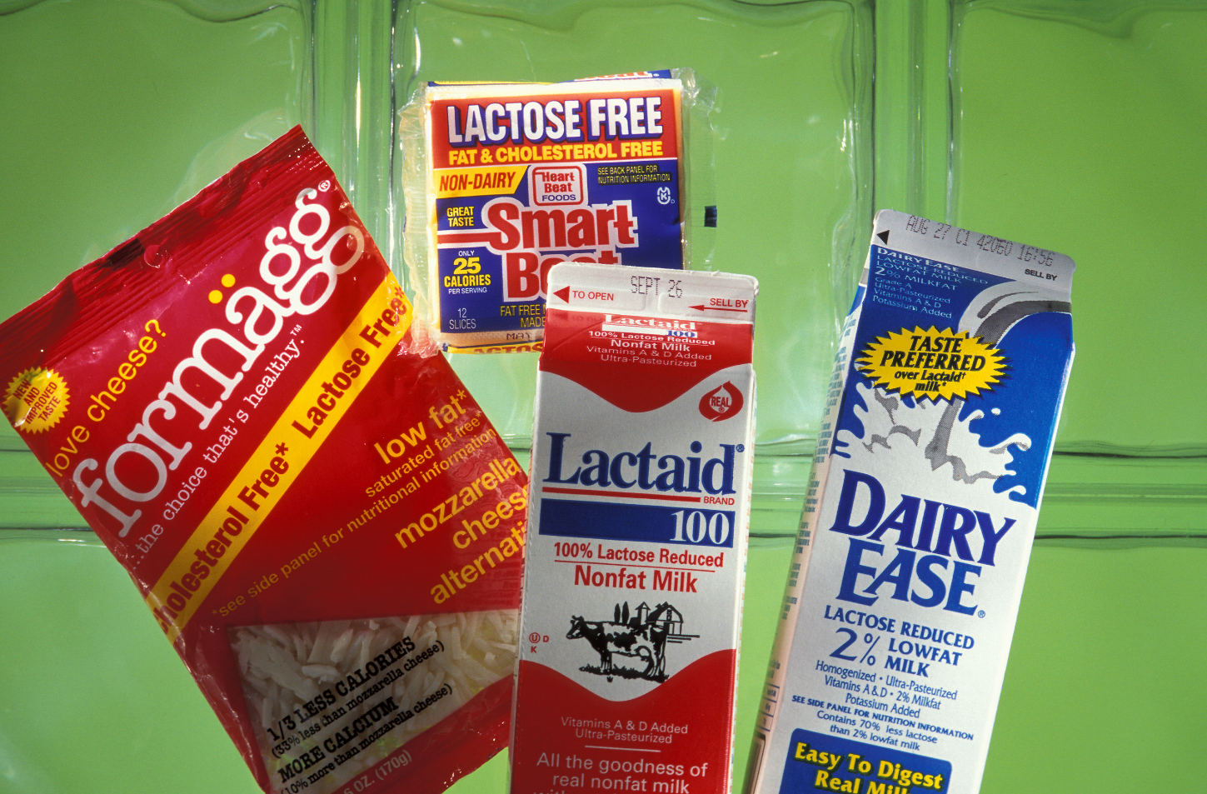

1982 Lactose-free milk
Virginia
Holsinger

Slide 36
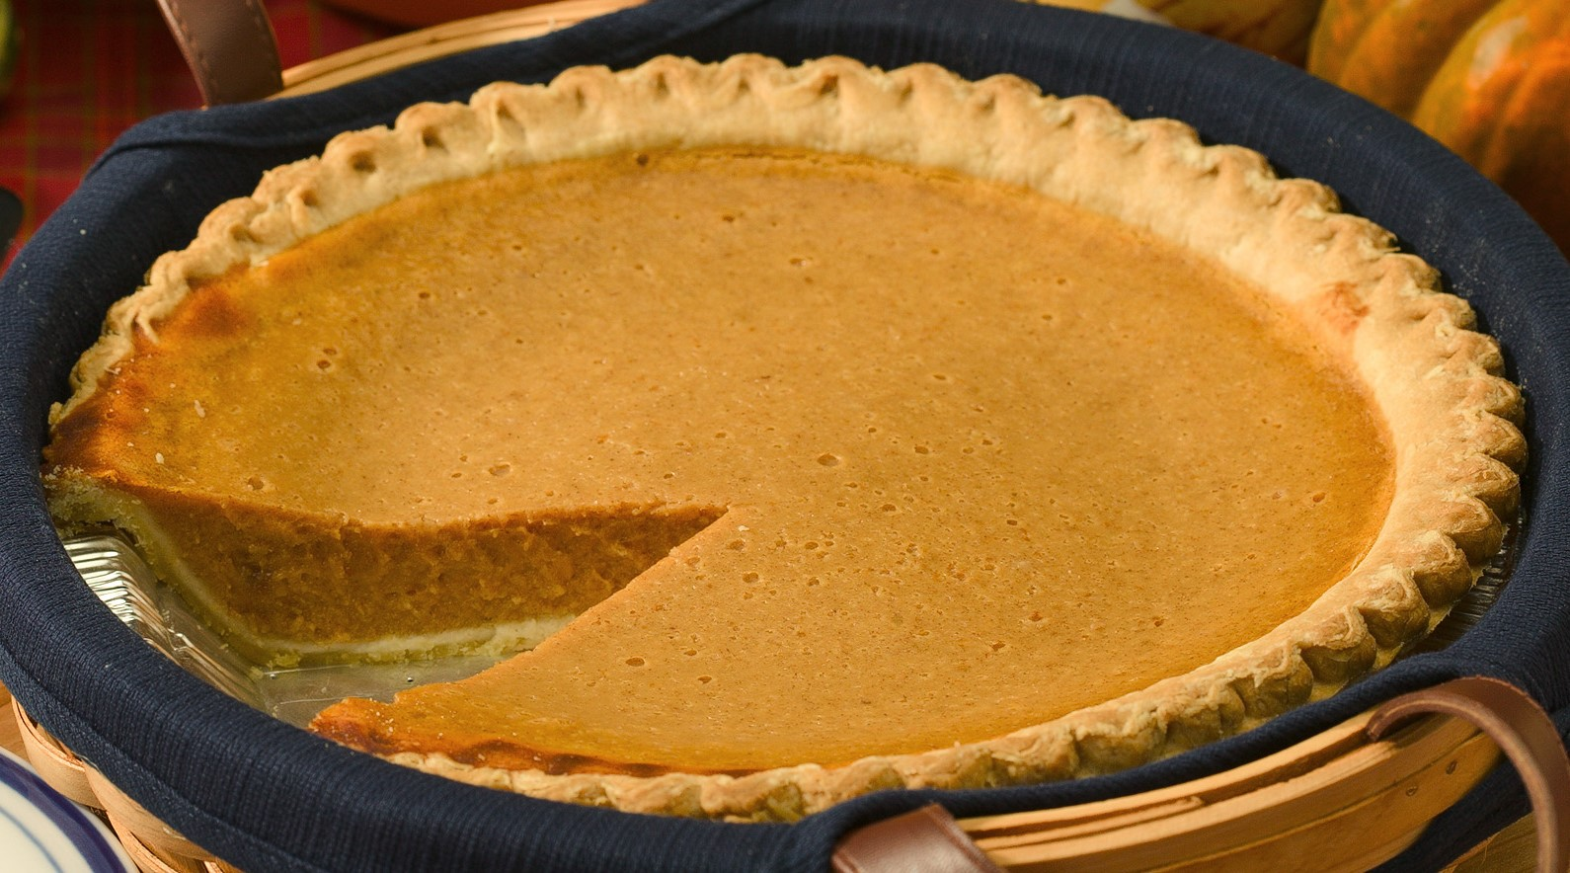

Slide 37
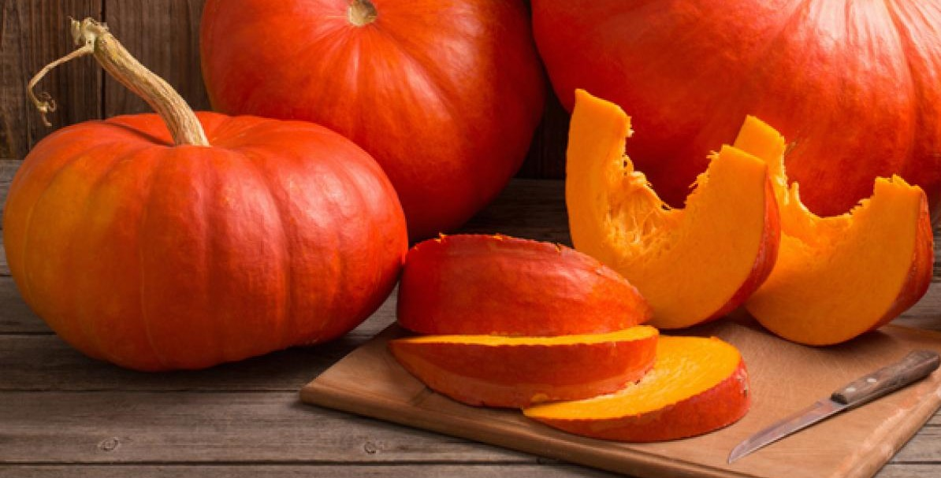
1939 ‘Early Cheyenne’
  Single pie pumpkin
  Flesh very deep color
  Disease tolerant
  Early harvest
LeRoy
Powers

Slide 38
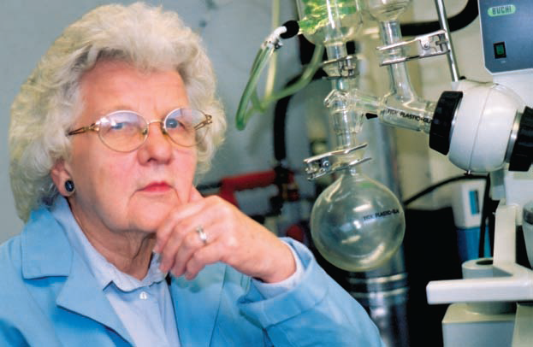

1976 Permanent Press Cotton
Ruth Benerito
2008

